Slide 1
Lex Li
Xamarin History

Slide 2

About Me
Senior .NET Developer
Microsoft MVP 2012-2019
Author of the book “.NET Legends”

Slide 3
Challenges for Microsoft

Slide 4

Microsoft in 1995
Conquering Desktops
Browser war was not yet started
Development Tools
Image source: Microsoft
Visual Basic and Visual C++

Slide 5

SUN Java
Compile Once, Run Everywhere
Cross platform enabler
Object Oriented
Evolution with design patterns, test driven development.
Image source: Oracle

Slide 6

Responses from Microsoft
Visual J++
Microsoft’s Java alike language to develop Windows applications
The Birth of C#/.NET
New platform after lawsuits with SUN
Photo by Pixabay (Pexels)

Slide 7

Microsoft Before 2007
PC OS
Windows XP
Server OS
Windows Server 2003
Photo by Pixabay (Pexels)

Slide 8

Revolution in 2007
Mobile OS
Apple iOS (iPhone/iPad)
Google Android
Mobile Development
Objective C
Java
Photo by Hasan Albari (Pexels)

Slide 9
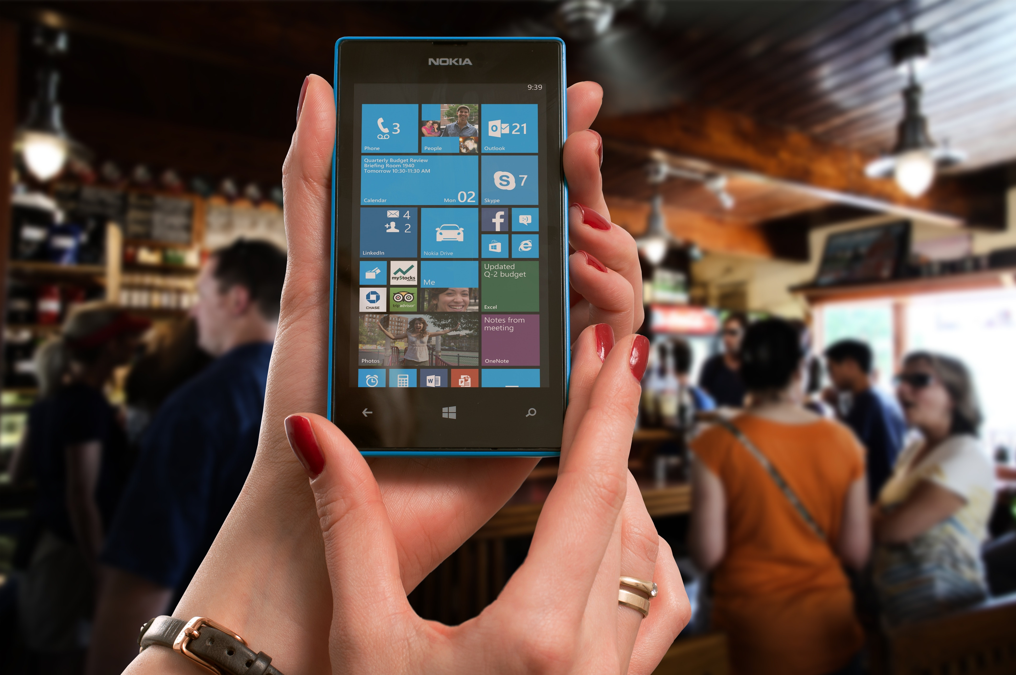
Microsoft Revenges
Windows Phone
C# + Silverlight
Windows 10 Mobile
C# + UWP
Photo by Pixabay (Pexels)

Slide 10

C# Mobile Developers?
C# on iOS
C# on Android
Photo by Pixabay (Pexels)

Slide 11
Magic From Xamarin

Slide 12

OSCON 2001
Miguel de Icaza
Leader of Linux Gnome project announced open source .NET clone
Image source: O’Reilly

Slide 13

Mono Project
Mono CLR
Open source CLR implementation based on open standards
An Ecosystem
C# compiler, MonoDevelop IDE, and platform bindings (GTK#)
Image source: The Mono Project

Slide 14
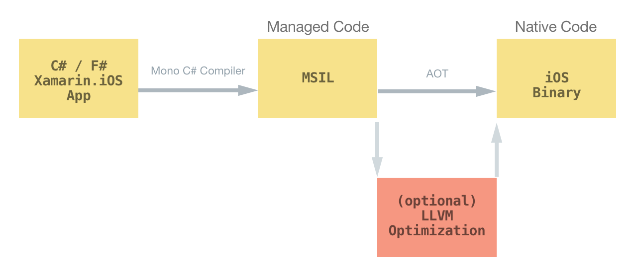
Ahead of Time Compilation
No JIT on iOS
iOS memory model prevents JIT from working
Native Code
Compilation result is native code, so equivalent to Objective C
Image source: Microsoft

Slide 15
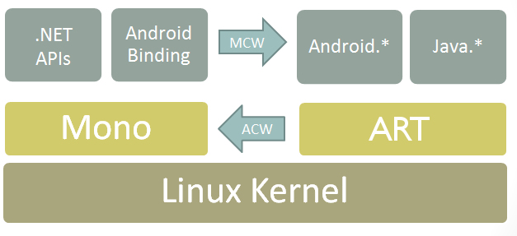
Dual Virtual Machines
Android Binds Java
NDK enables Mono to work with Java VM (ART)
Java -> C# Translation
C# bindings to Android native API, reduction of shared objects
Image source: Microsoft

Slide 16

Xamarin
Xamarin.iOS
Xamarin.Android
Image source: Microsoft

Slide 17
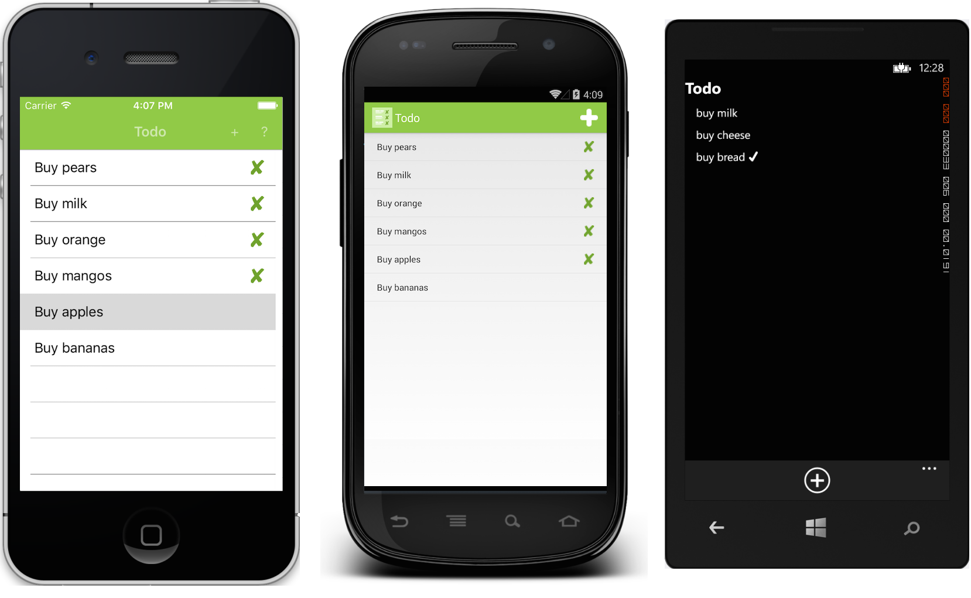
Xamarin.Forms
Cross Platform UI
XAML to describe UI elements
Nave Look-And-Feel
Native rendering and native control embedding
Image source: Microsoft

Slide 18
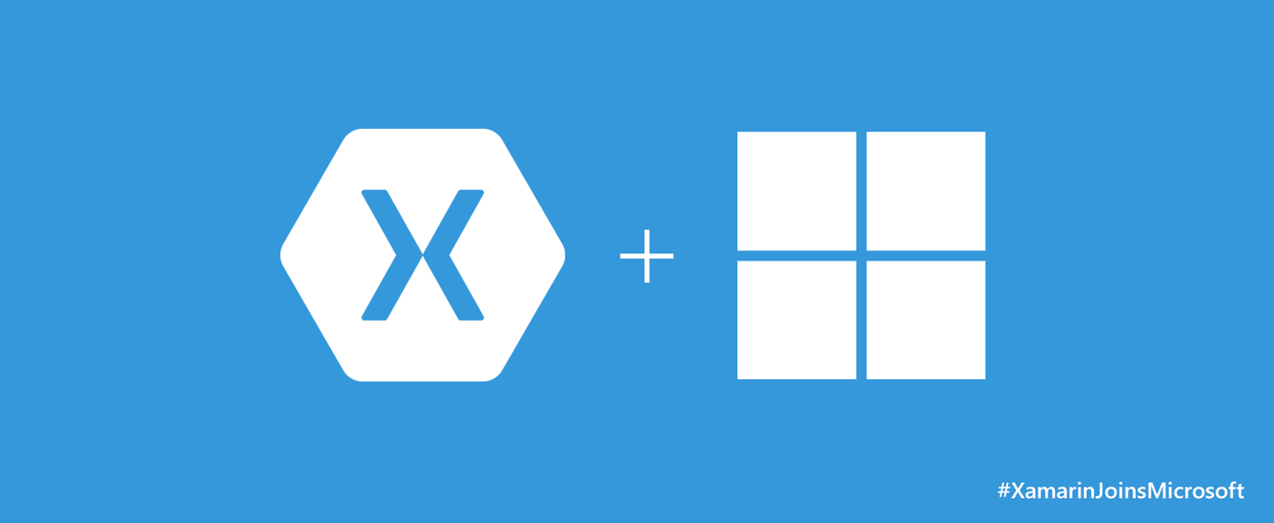
Acquisition
Cloud and Edge
Fill the gaps on mobile development
Community Unified
Combine .NET/Mono/Xamarin communities into a single one
Image source: Microsoft

Slide 19
Future of .NET

Slide 20

Issues
Issues on Mono
Legacy code and incompatibilities
Issues on Code Reuse
Anything beyond Xamarin.Forms
Photo by Pixabay (Pexels)

Slide 21
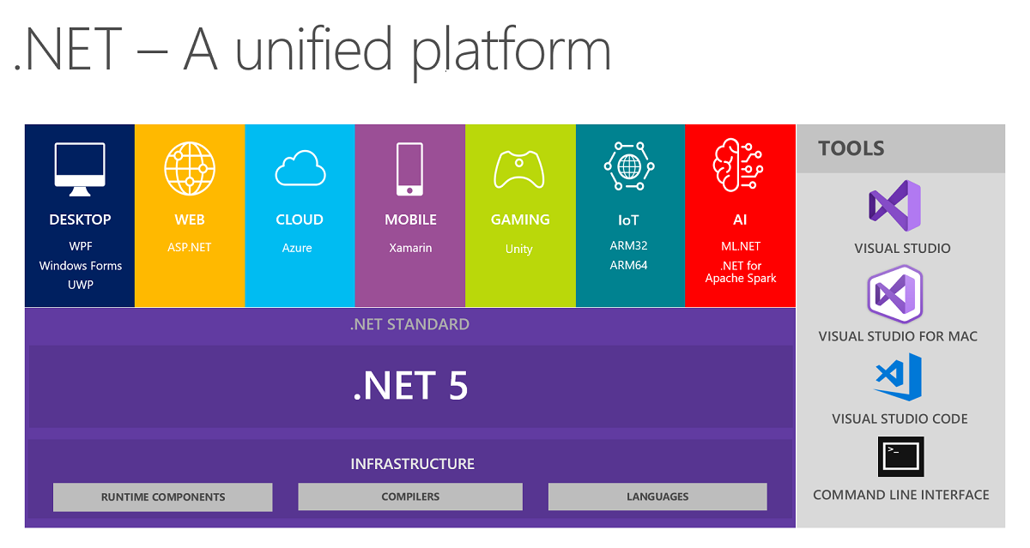
Directions
.NET + Mono
.NET 5 in 2020 unifies the platform to a common foundation
Xamarin.Essentials
More and more platform differences are abstracted away
Image source: Microsoft

Slide 22
Thanks for watching!

